Slide 1
New York State Offshore Wind Master Plan
Energy Policy Roundtable
in the PJM Footprint
May 23, 2018
Peter Olmsted, Assistant Secretary for Energy, Office of Governor Andrew. M. Cuomo

Slide 3
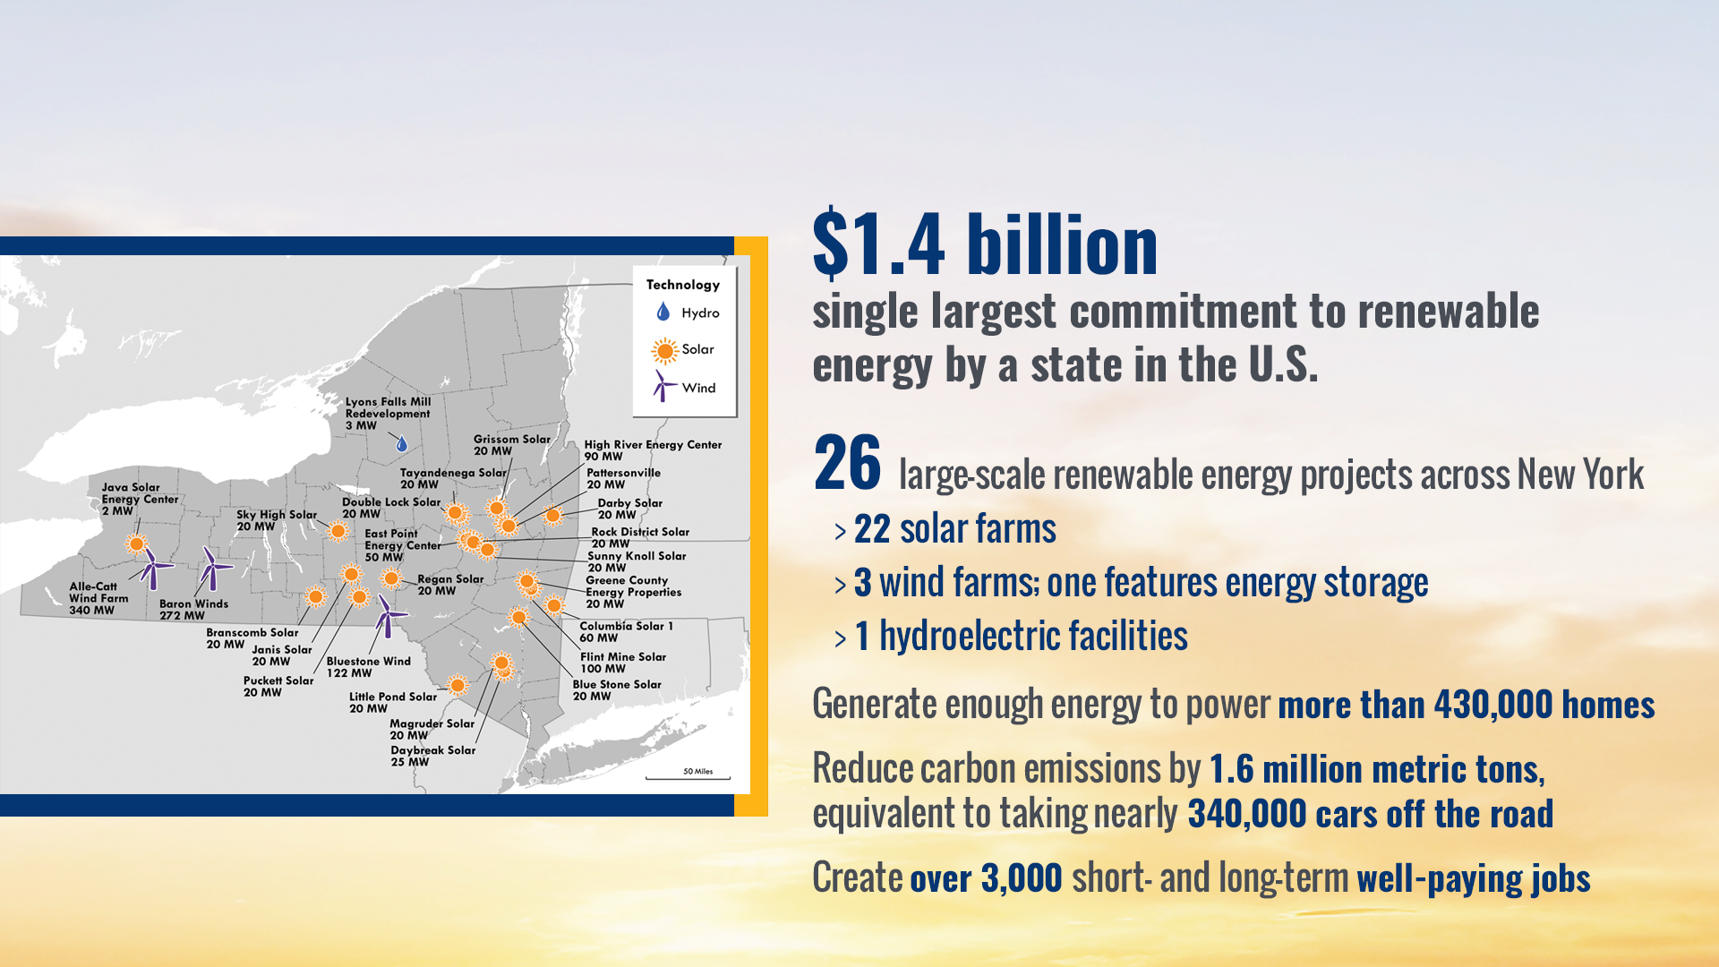
Large-Scale Renewable Energy Standard Projects

Slide 5
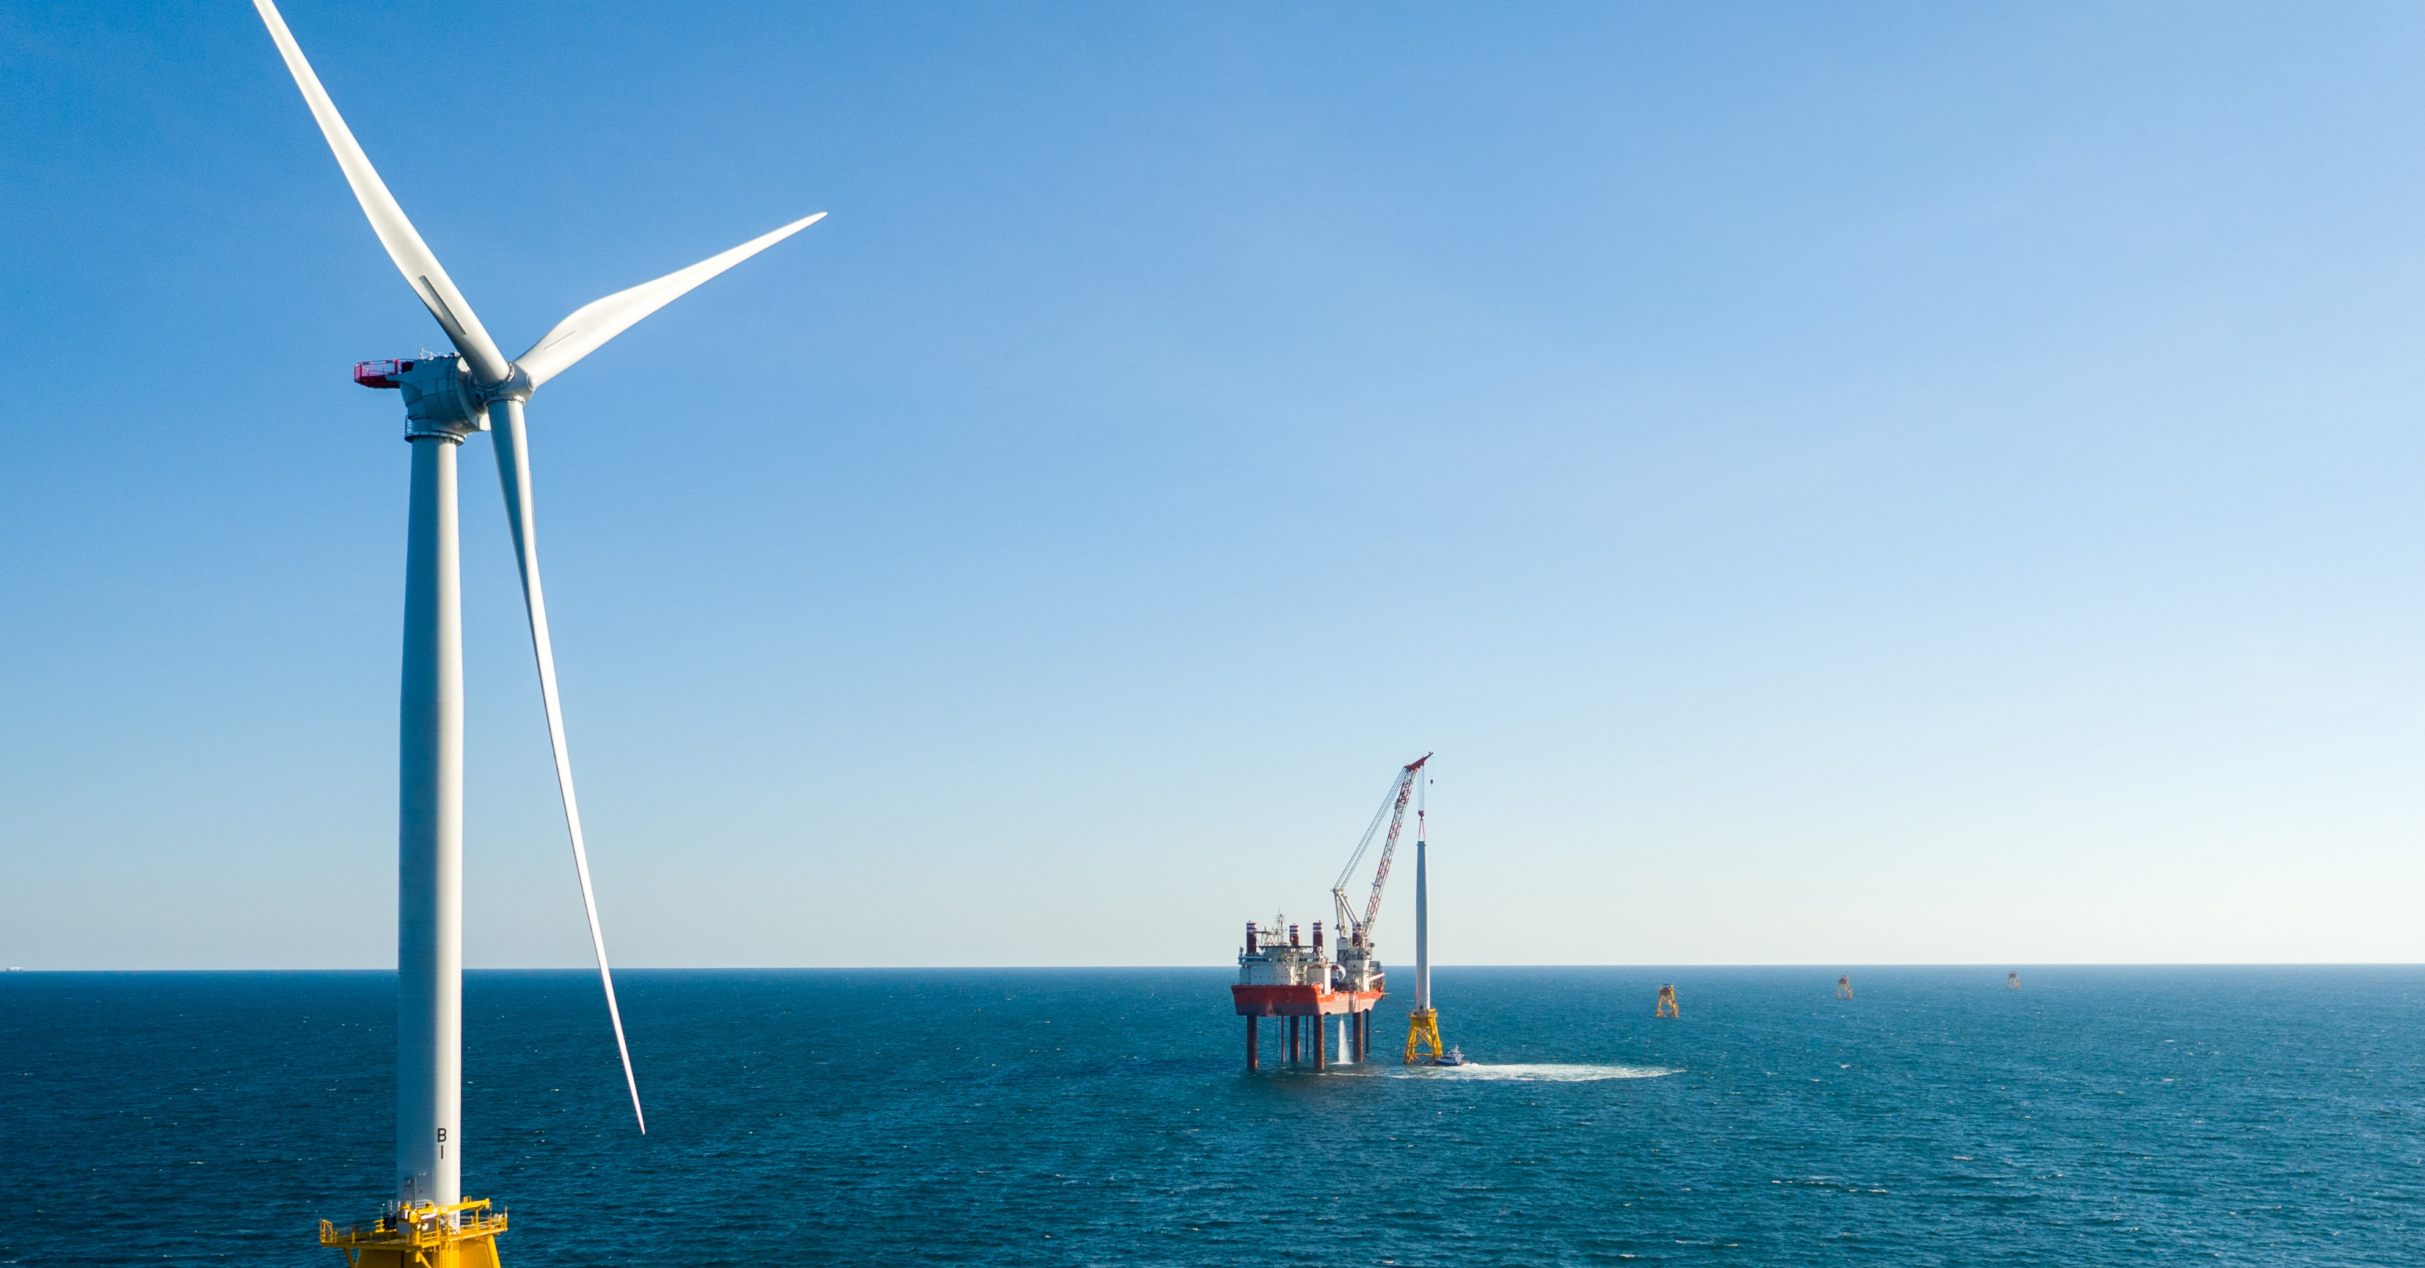
LIPA South-Fork Wind Farm
New York’s first offshore wind farm
Operational: 2022
30 miles southeast of Montauk
Powering 40,000 homes with 15 turbines (90 MW)
Least cost option to meet increasing electricity demand on the South Fork while meeting New York’s clean energy goals

Slide 6
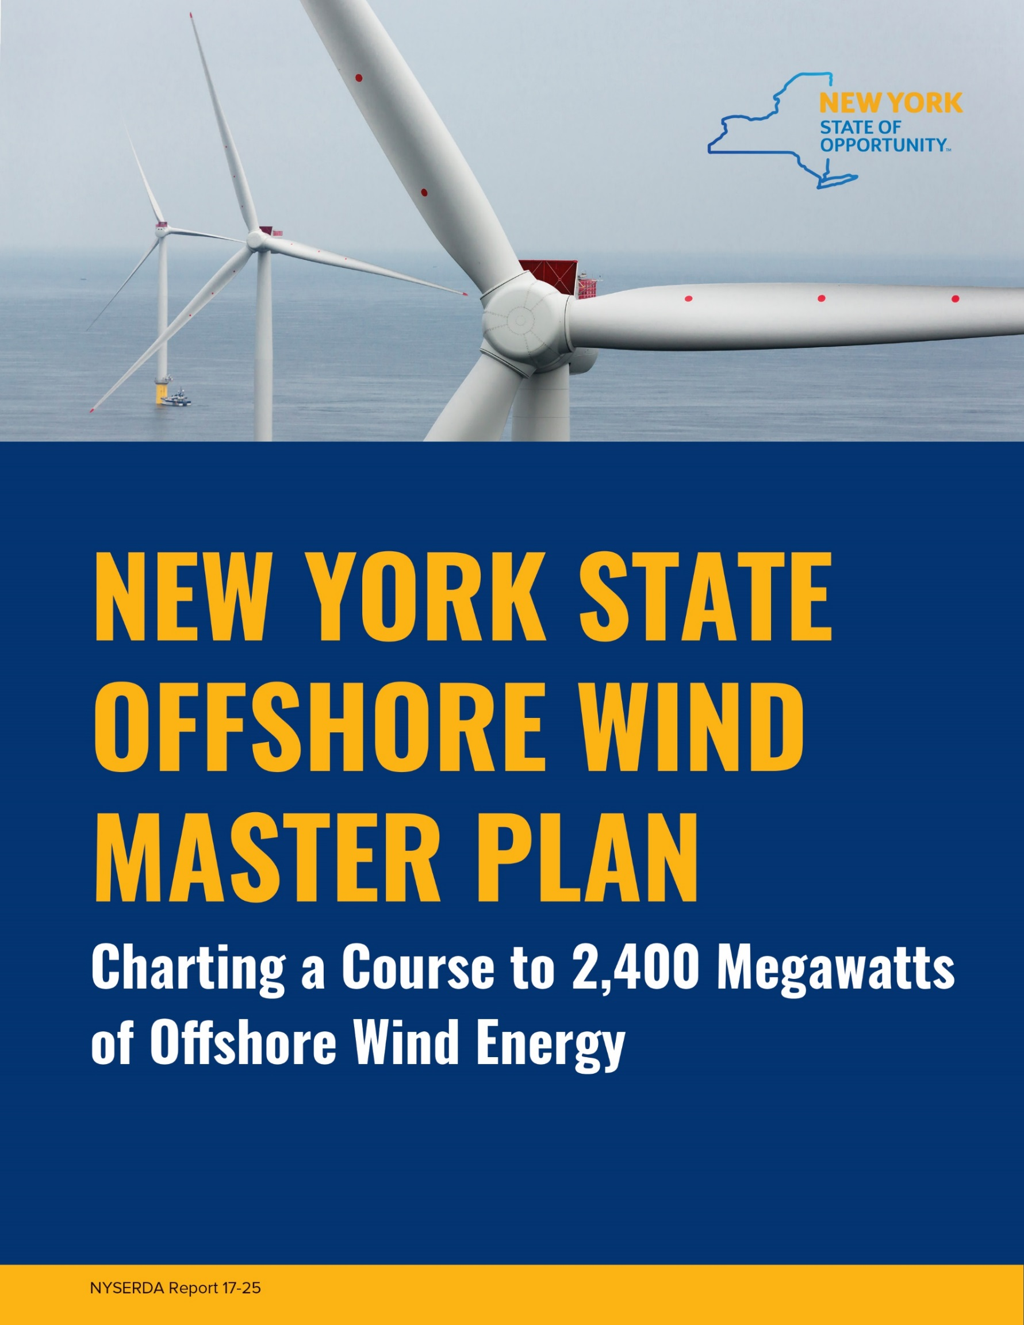
Offshore Wind Master Plan
A comprehensive state roadmap for advancing development of offshore wind in a cost-effective and responsible manner.
Key Elements
Identifies the most favorable areas for potential offshore wind energy development
Describes the economic and environmental benefits of offshore wind energy development

Slide 7
Offshore Wind Master Plan
Addresses mechanisms to procure offshore wind energy at the lowest ratepayer cost
Analyzes costs and cost-reduction pathways
Recommends measures to mitigate potential impacts of offshore wind energy development
Identifies infrastructure requirements and assesses existing facilities
Identifies workforce opportunities

Slide 8
20 Master Plan Studies and Surveys
Study name
Analysis of Multibeam Echo Sounder and Benthic Survey Data
Assessment of Ports and Infrastructure
Aviation and Radar Assets Study
Birds and Bats Study
Cable Landfall Permitting Study
Cables, Pipelines, and Other Infrastructure
Consideration of Potential Cumulative Effects
Cultural Resources Study
Environmental Sensitivity Analysis
Fish and Fisheries Study
Health and Safety Study
Study name (cont’d)
Marine Mammals and Sea Turtles Study
Marine Recreational Uses Study
Offshore Wind Injection Assessment
Preliminary Offshore Wind Resource Assessment
Sand and Gravel Resources Study
Shipping and Navigation Study
U.S. Jones Act Compliance Offshore Wind Turbine Installation Vessel Study
Visibility Threshold Study
The Workforce Opportunity of Offshore Wind in New York

Slide 9
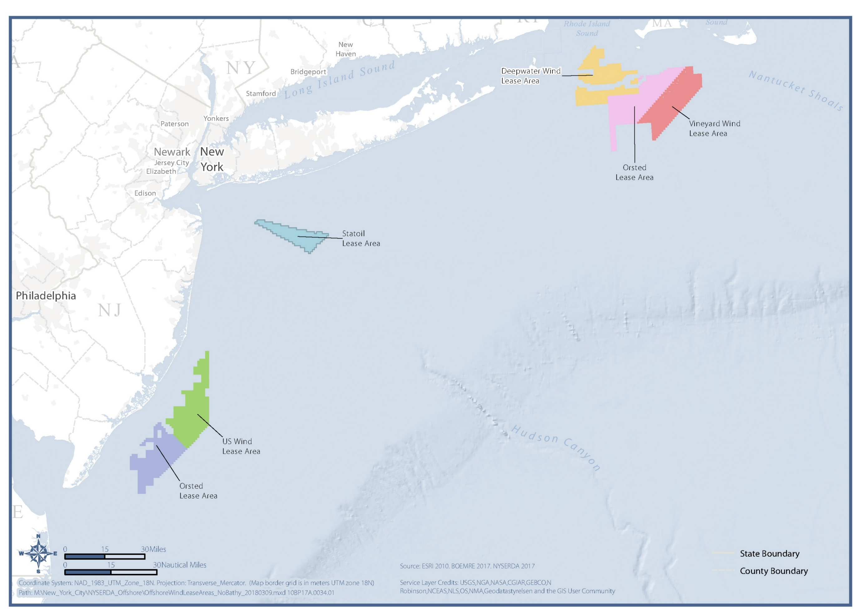
Regional Offshore Wind Lease Areas

Slide 10
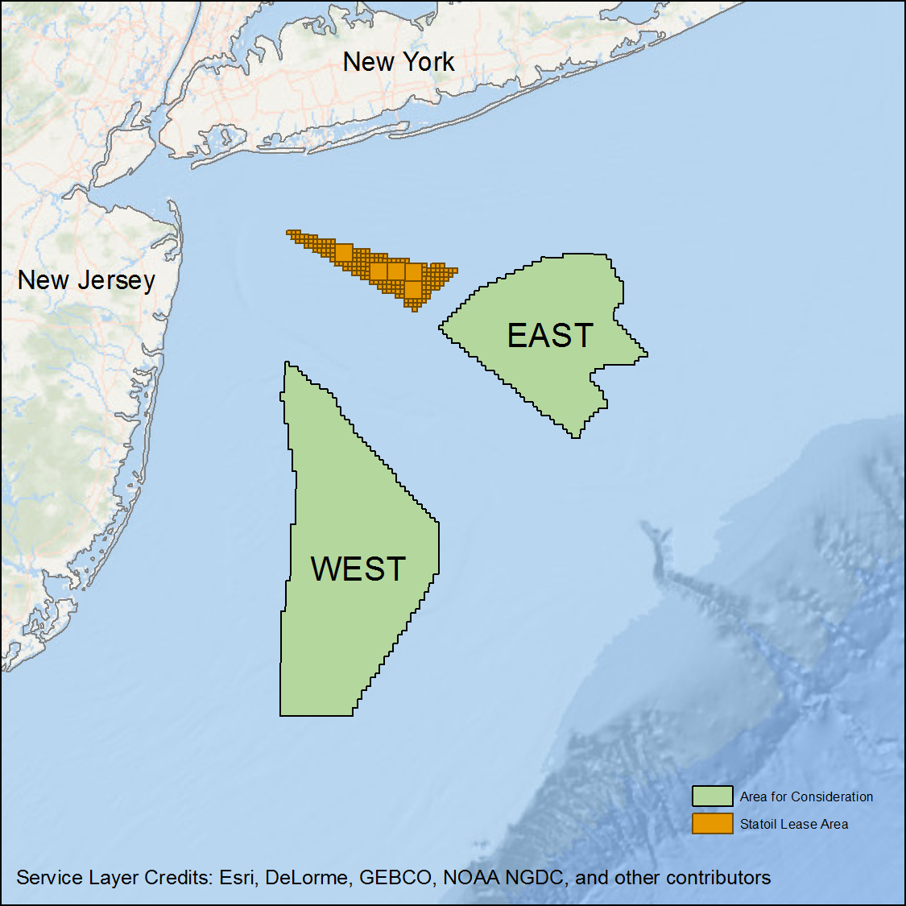
Area for Consideration
October 2017
New York State identified an Area for Consideration and requested that the federal Bureau of Ocean Energy Management identify and lease at least four new Wind Energy Areas within the area, each capable of supporting at least 800 MW of offshore wind.

Slide 11
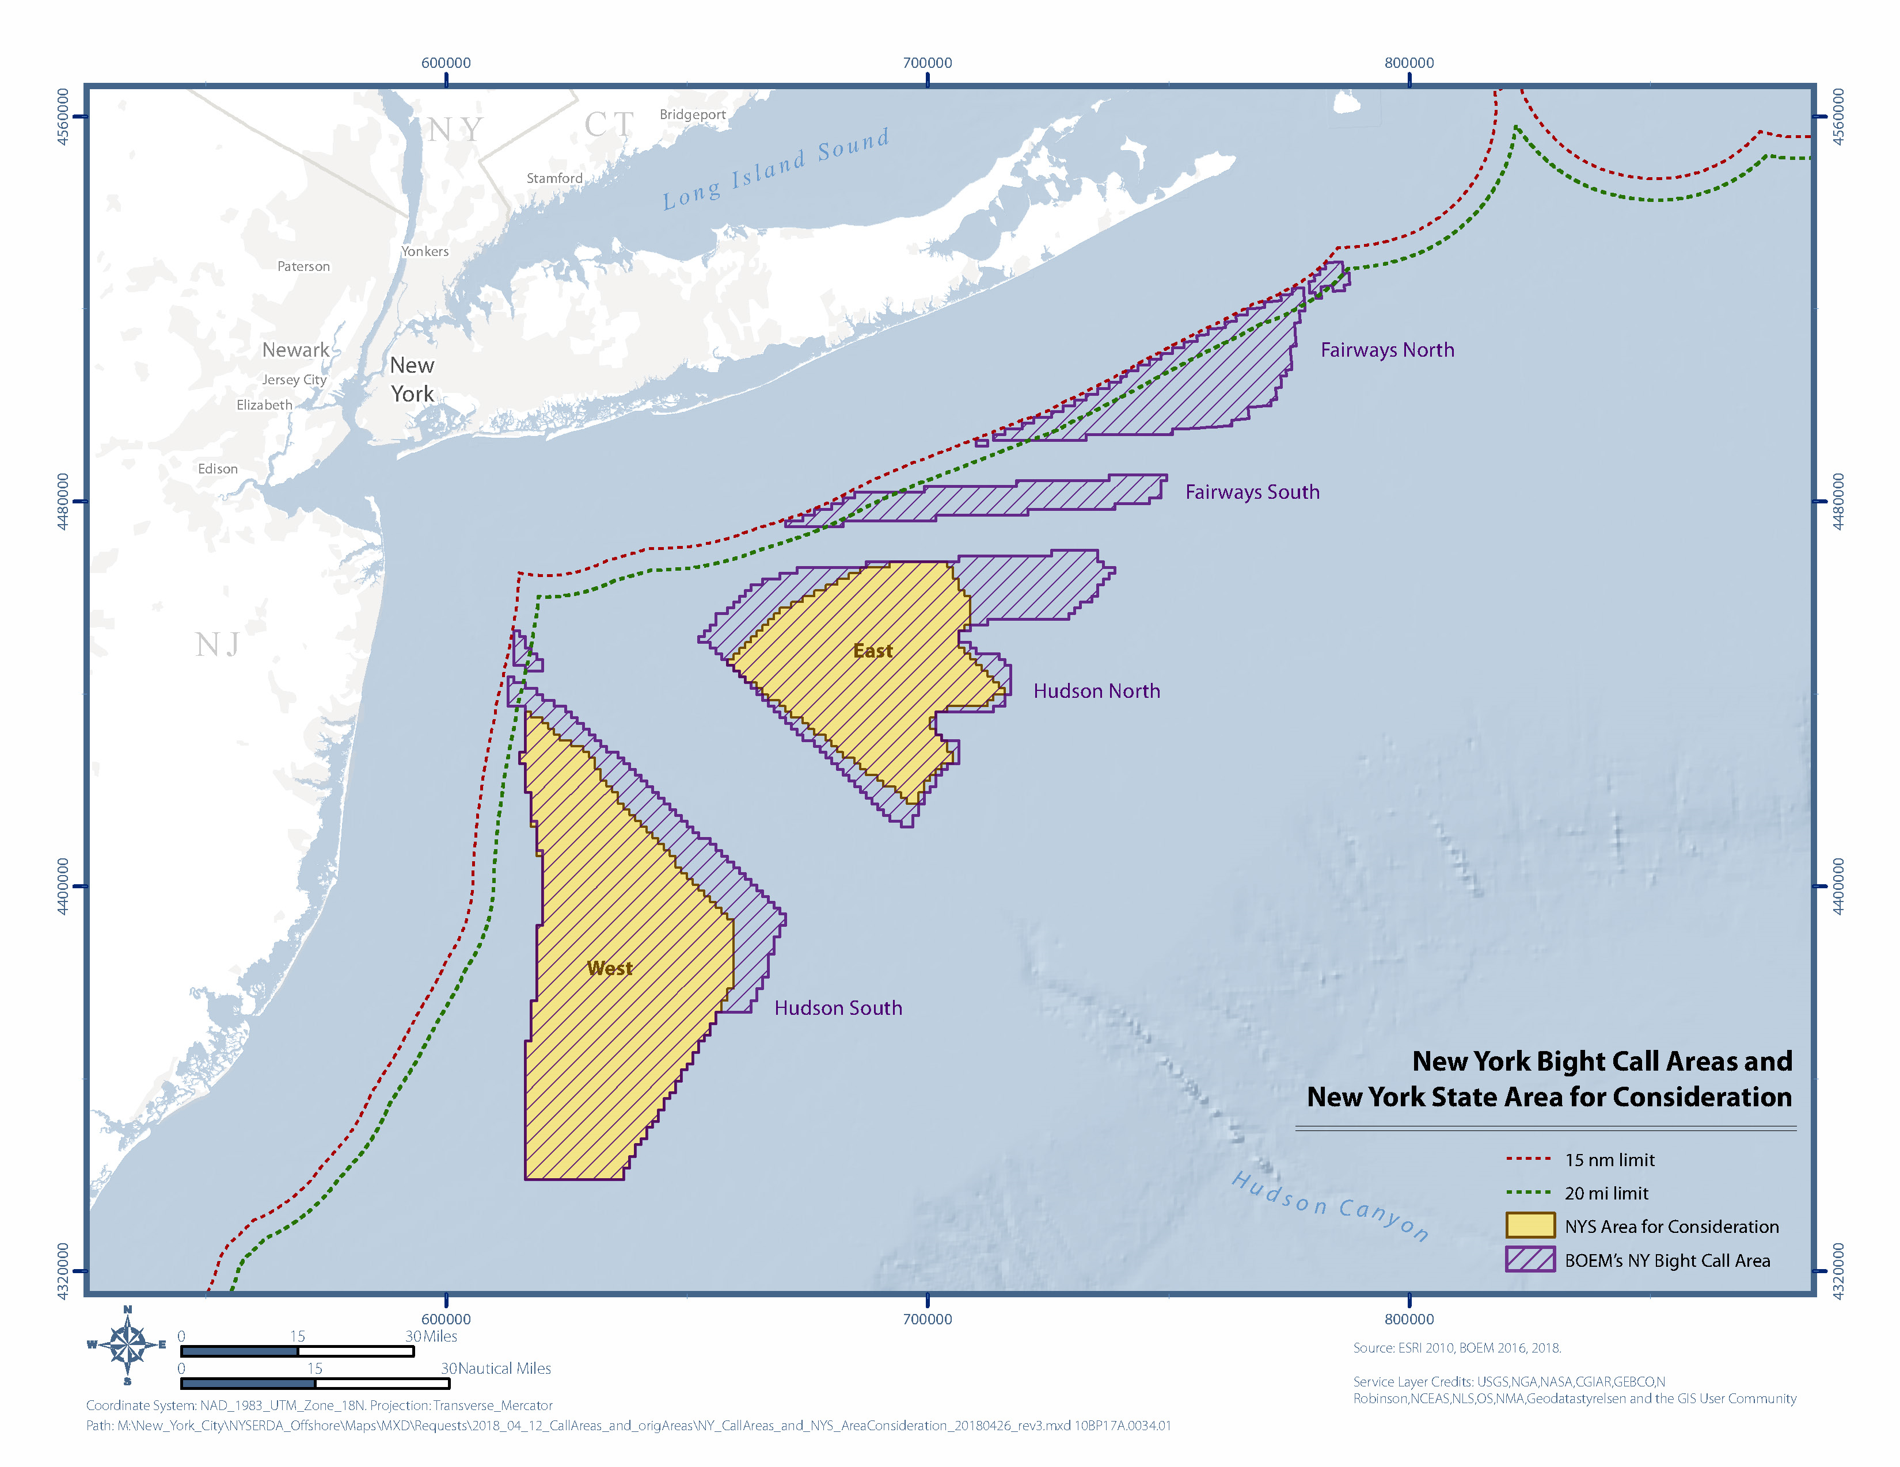
BOEM Call Areas and NY’s Area for Consideration
Comments on the New York Bight Call Areas can be provided to BOEM online at: https://www.boem.gov/NY-Bight/
Comments are due July 30th
Notes:
Using all of these studies and public/stakeholder feedback, the State recommended the Area for Consideration to BOEM in October 2017.
This AfC is the area that the State believes presents the greatest opportunity and least risk for the responsible and cost effective development of OSW.
BOEM is asking for feedback, just as NYS did, and will be identifying sites based in part on that feedback.
The NYS will issue comments, providing more details on how it identified the AfC and reinforcing that the AfC is best place to site OSW
The State encourages others to weigh in as well.

Slide 13
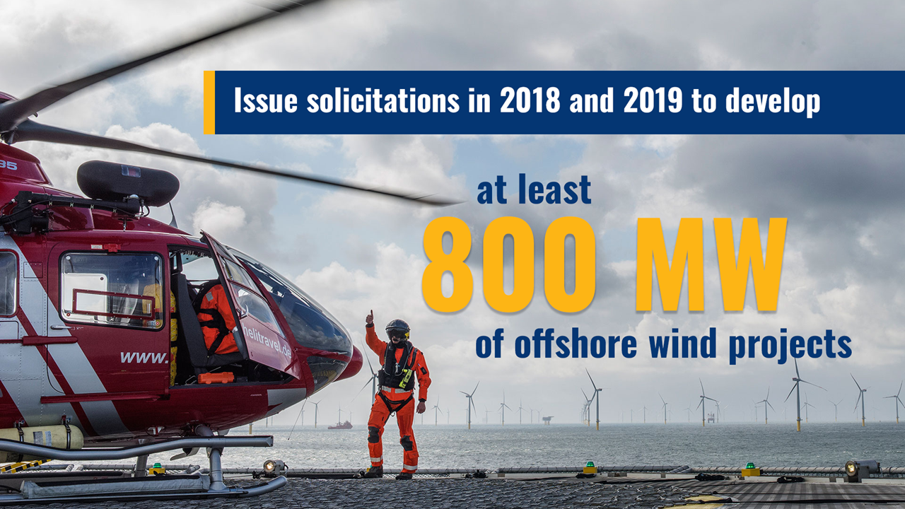

Slide 14
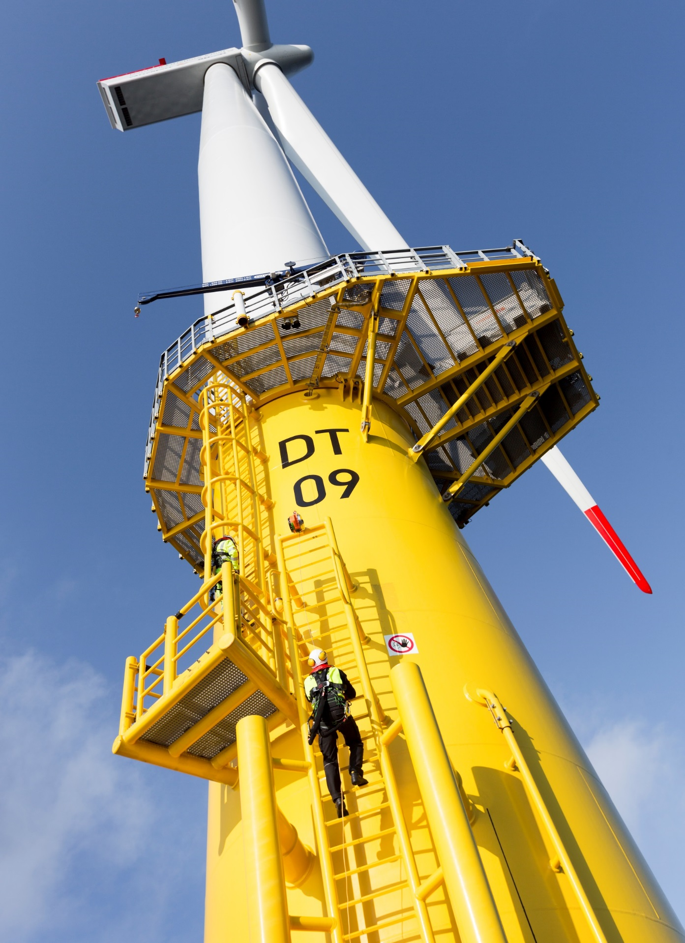
Offshore Wind Policy Options Paper
NYSERDA filed an Offshore Wind Policy Options Paper with the New York Public Service Commission (PSC) with options on a wide range of policy issues to successfully deliver the first phase (at least 800 MW) of offshore wind energy to New York.
Components include:
Procurement and Contracting
Funding through Load Serving Entity Obligations
Transmission and Interconnection
Cost and Benefits Analysis

Slide 15
Offshore Wind Policy Options Paper (cont’d)
The PSC will issue an Order selecting solutions to these policy issues. The public comment period on NYSERDA’s options ends June 4.
The open comment period focuses on questions such as:
Who should buy the power?
How should project risks be shared?
How will the projects be evaluated?
How are costs shared?

Slide 16
Ongoing Activities to Advance Offshore Wind

Slide 17
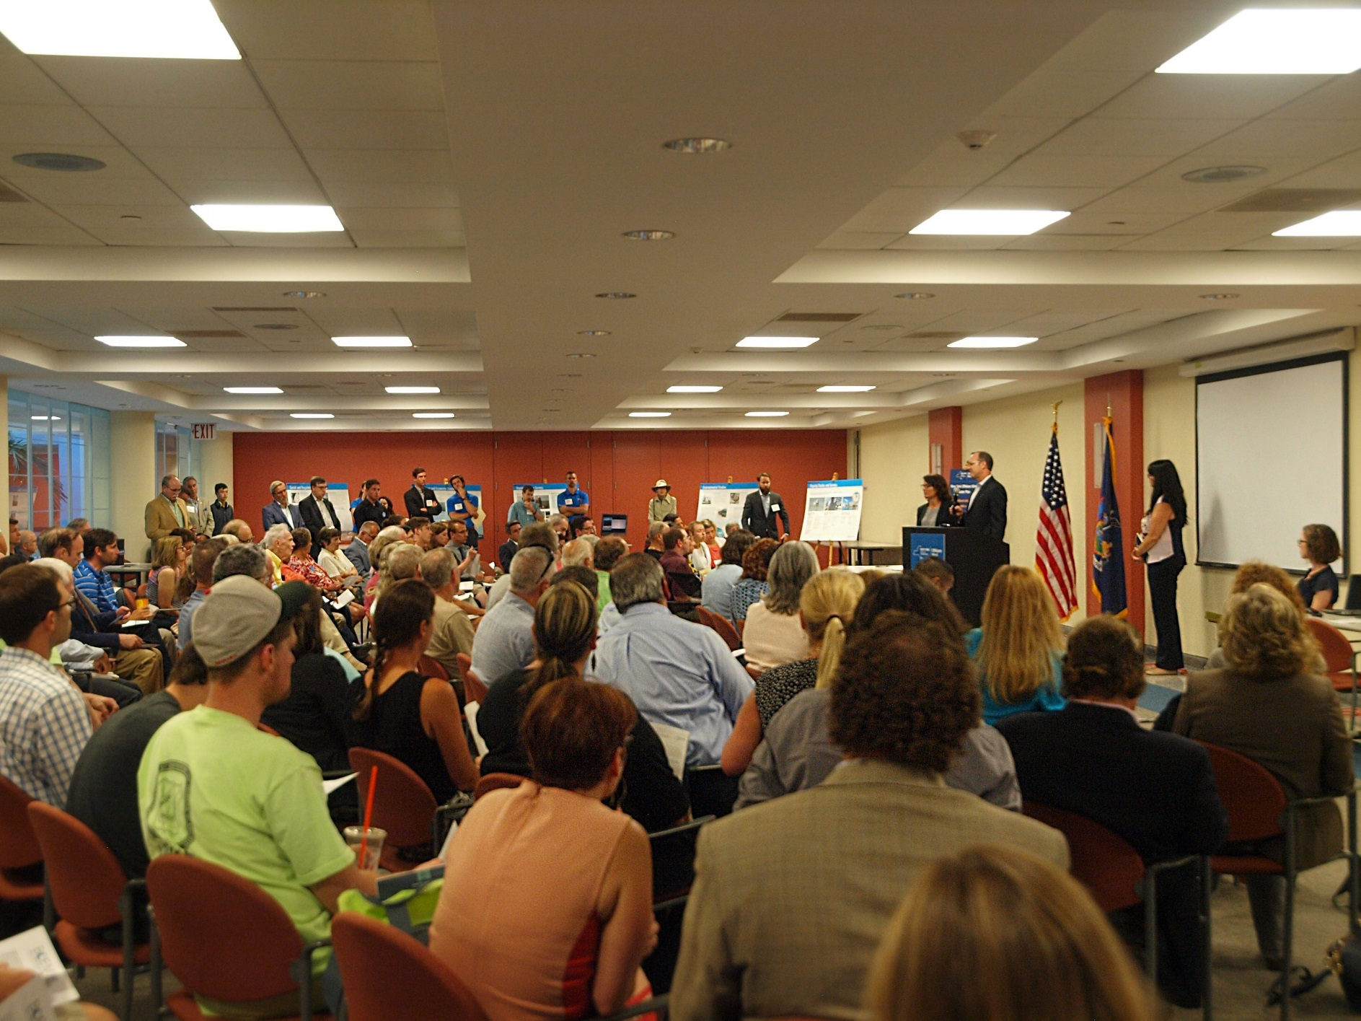
Continued Public Engagement
Commercial and Recreational Fishing
Consumer Advocates
Elected Officials
Indigenous Nations
Labor and Business
Long Island and New York City Communities
Non-Governmental Organizations
Offshore Wind Energy Industry
State and Federal Agencies
Submarine Cables and Offshore Infrastructure Owners

Slide 18
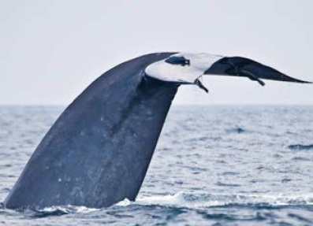
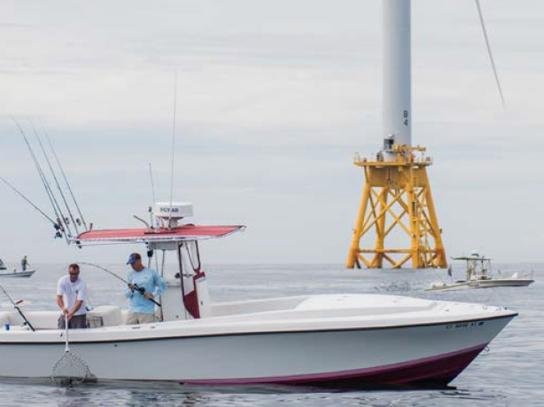
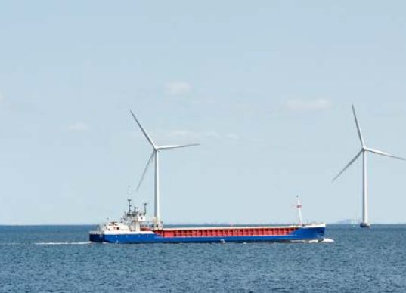
Technical Working Groups
Environmental
Commercial and Recreational Fishing
Maritime
Jobs and Supply Chain
Development of Wildlife Best Management Practices.
Coordination for adaptive management.
Identification of research needs and coordination.
Development of Fisheries Best Management Practices.
Identification of research needs and coordination.
Development of a framework for understanding commercial fishing impacts.
Development of Maritime Best Management Practices.
Define strategies that could help members engage effectively with OSW development.
Facilitate the connection of local manufacturers with global OSW developers and equipment manufacturers.
Ensure certification and training requirements are clear and readily available.

Slide 19
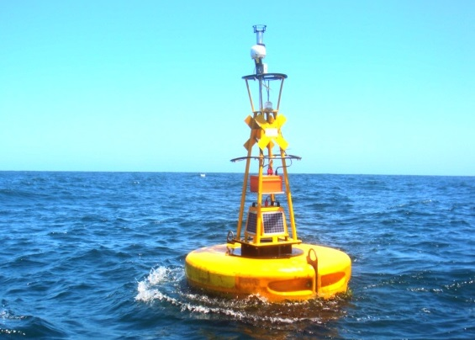
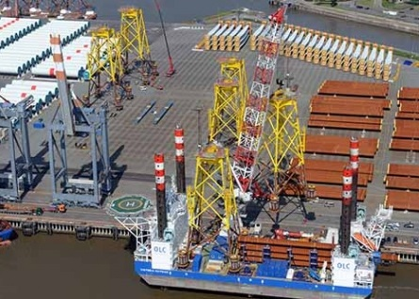
Future Studies and Analysis
Metocean
Air Quality
Wildlife
Supply Chain
Improve characterization of the wind, wave and ocean current environment.
Useful in refining project layouts and reducing project uncertainty.
Explore undertaking a detailed assessment of the air quality and health impacts of achieving New York’s 2030 goals.
Refine the understanding of the hourly impacts of offshore wind generation in relation to the demands of the grid.
Collaborate with appropriate federal and state agencies, universities and scientists to collect baseline data.
Map seasonal patterns to assist the identification of important habitat areas and predict future areas of high use.
Collaborate with industry to study how New York can best support the OSW supply chain.
Analyze technical challenges to envision a path forward for the broader US industry.

Slide 20
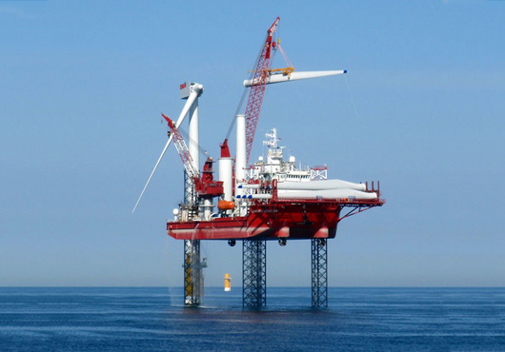
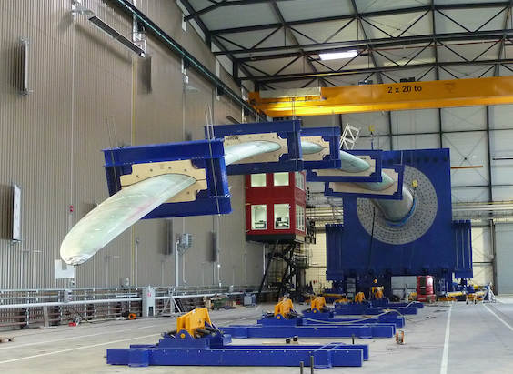
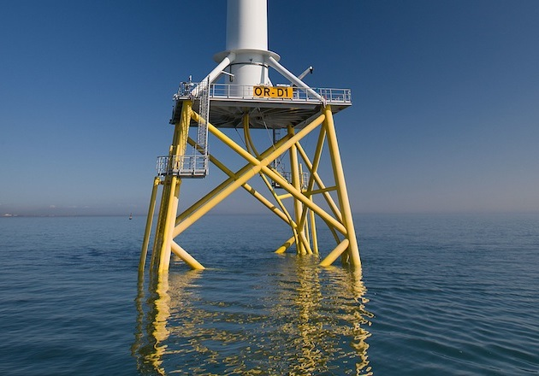
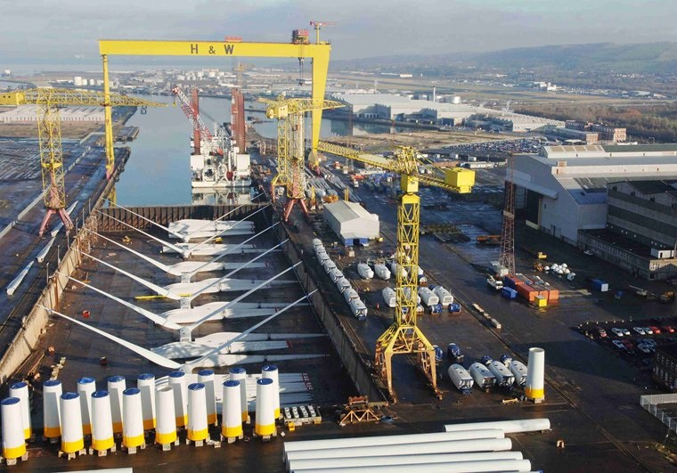
Research and Development
Component design
Systems design
Operational controls
Monitoring systems
Manufacturing processes

Slide 21
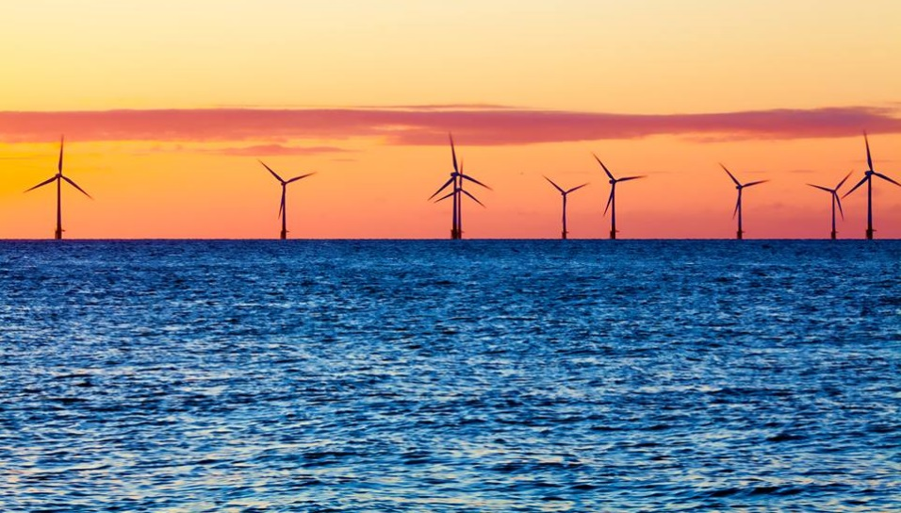
Contact Information:
www.nyserda.ny.gov/offshorewind
offshorewind@nyserda.ny.gov
Questions?

